Slide 1
Image Processing(Image Compression) Lecture: 4
Notes:
1

Slide 2
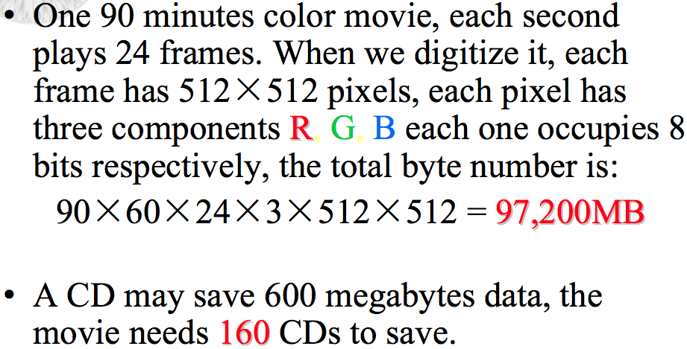
Why we need image compression?
Notes:
2

Slide 3
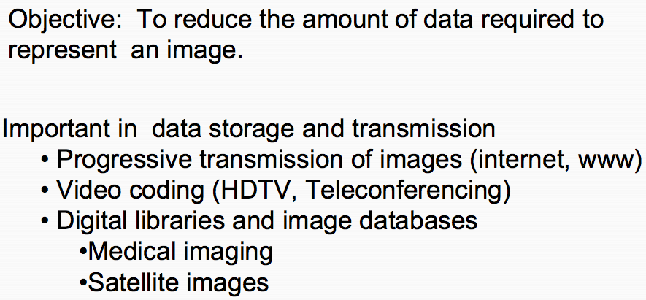
Image Compression
Notes:
3

Slide 4
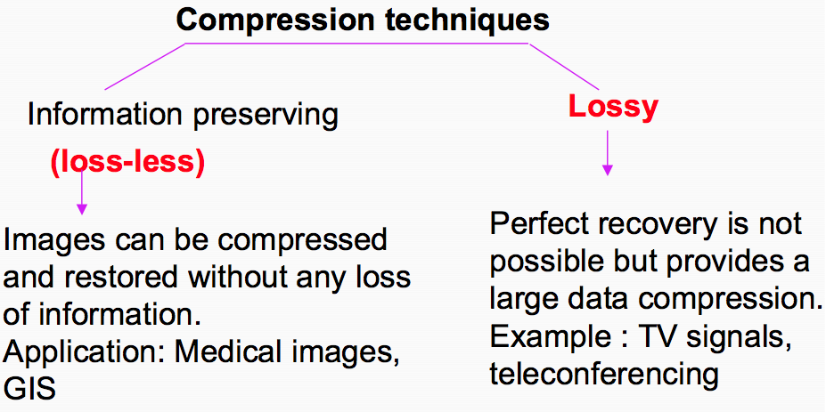
Lossy Vs. Lossless Compression
Notes:
4

Slide 5
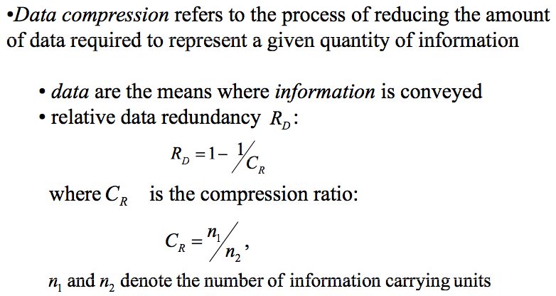
Image Compression
Notes:
5

Slide 6
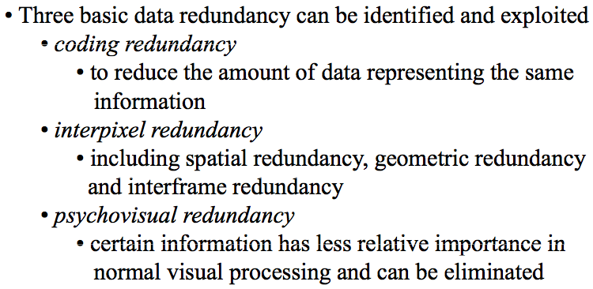
Image Compression
Notes:
6

Slide 7
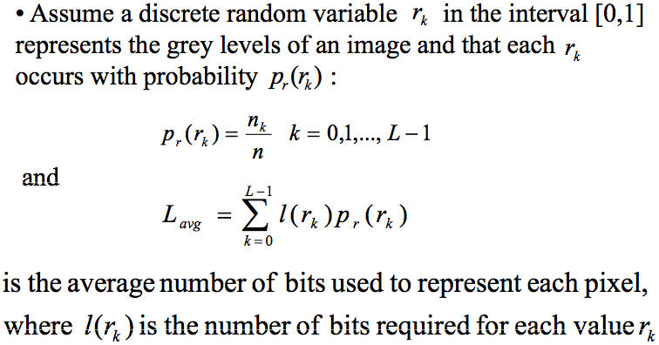
Coding Redundancy
Notes:
7

Slide 8
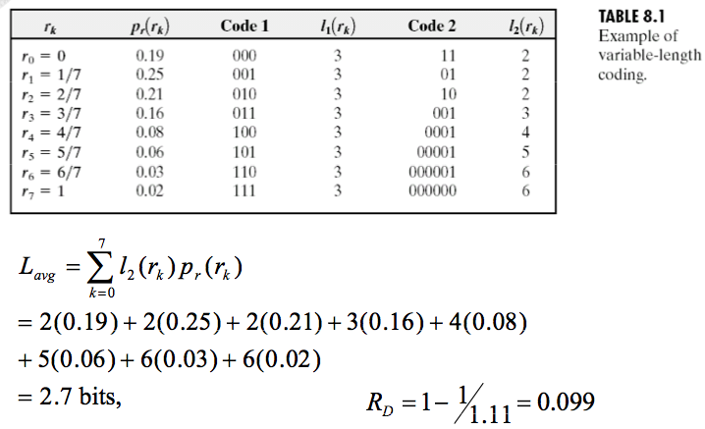
Coding Redundancy
Notes:
8

Slide 9
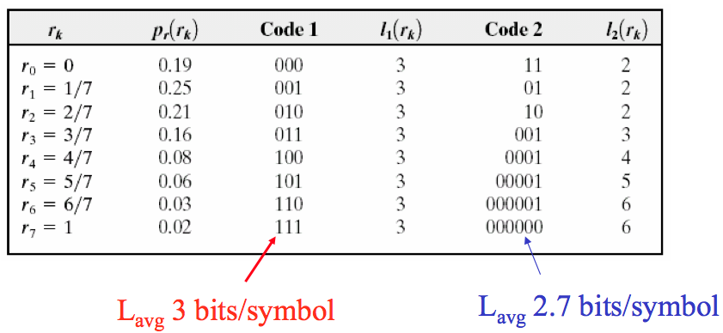
Coding Redundancy
Notes:
9

Slide 10
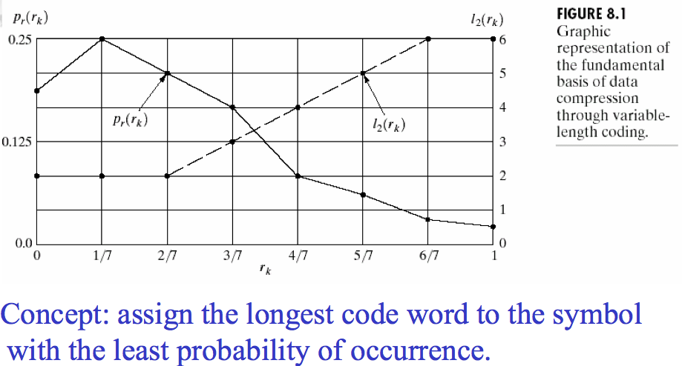
Coding Redundancy
Notes:
10

Slide 11
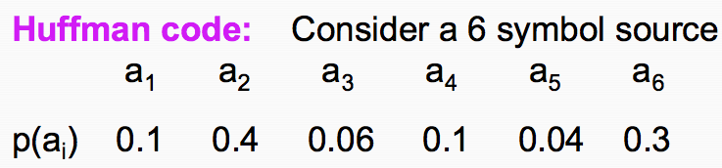
Huffman coding
Notes:
11

Slide 12
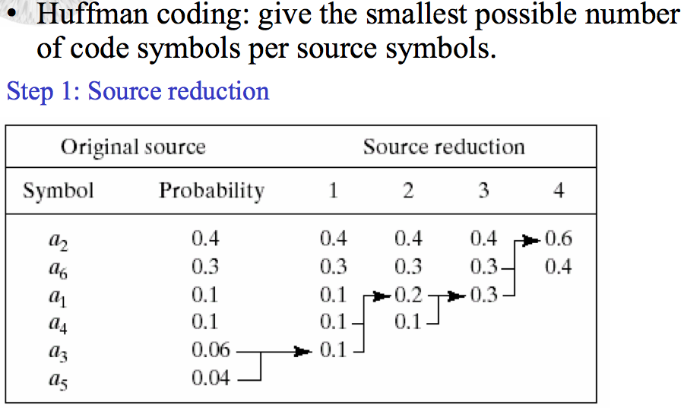
Huffman coding
Notes:
12

Slide 13
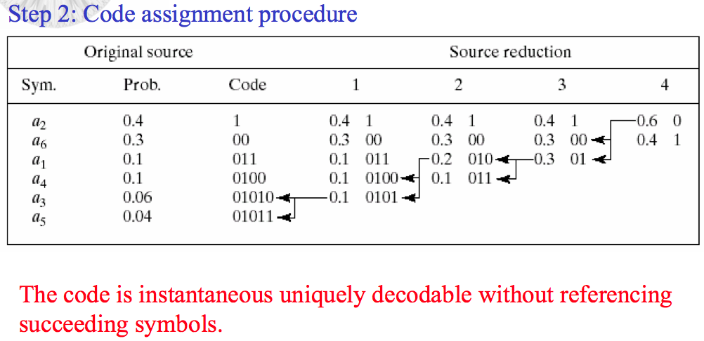
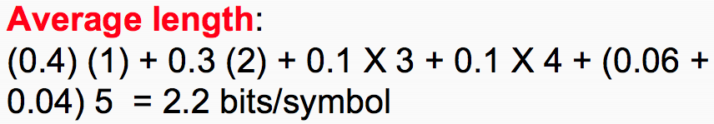
Huffman coding
Notes:
13

Slide 14
Fixed Length: LZW Coding
Error Free Compression Technique
Remove Inter-pixel redundancy
Requires no priori knowledge of probability distribution of pixels
Assigns fixed length code words to variable length sequences
Patented Algorithm US 4,558,302
Included in GIF and TIFF and PDF file formats

Slide 15
LZW Coding
Coding Technique
A codebook or a dictionary has to be constructed
For an 8-bit monochrome image, the first 256 entries are assigned to the gray levels 0,1,2,..,255.
As the encoder examines image pixels, gray level sequences that are not in the dictionary are assigned to a new entry.
For instance sequence 255-255 can be assigned to entry 256, the address following the locations reserved for gray levels 0 to 255.

Slide 16
LZW Coding
Example
Consider the following 4 x 4 8 bit image
39 39 126 126
39 39 126 126
39 39 126 126
39 39 126 126
Dictionary Location Entry
0 0
1 1
. .
255 255
256 -
511 -
Initial Dictionary

Slide 17
LZW Coding
39 39 126 126
39 39 126 126
39 39 126 126
39 39 126 126
Is 39 in the dictionary……..Yes
What about 39-39………….No
Then add 39-39 in entry 256
And output the last recognized symbol…39
Dictionary Location Entry
0 0
1 1
. .
255 255
256 -
511 -
39-39

Slide 18
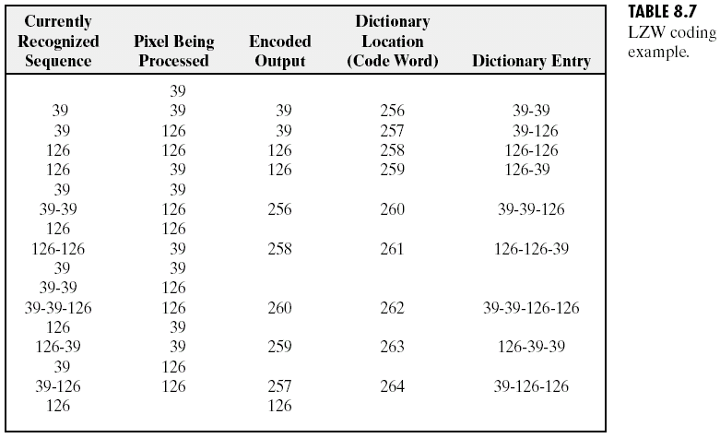
LZW Coding

Slide 19
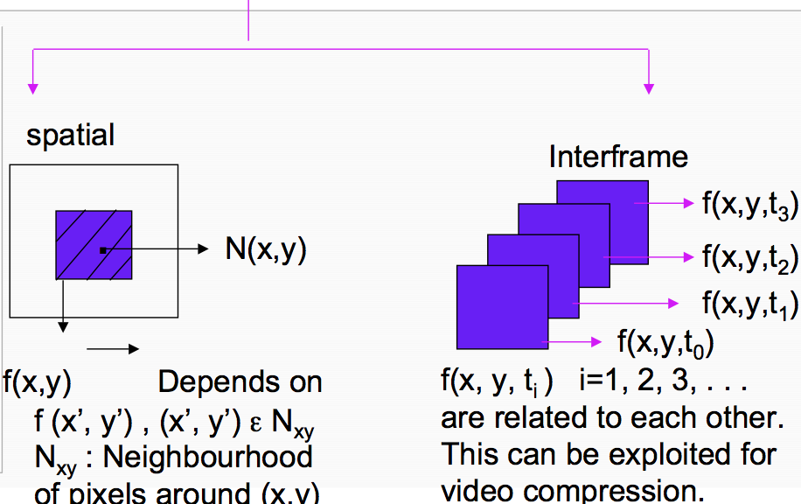
Interpixel / Interframe Redundancy
Notes:
19

Slide 20
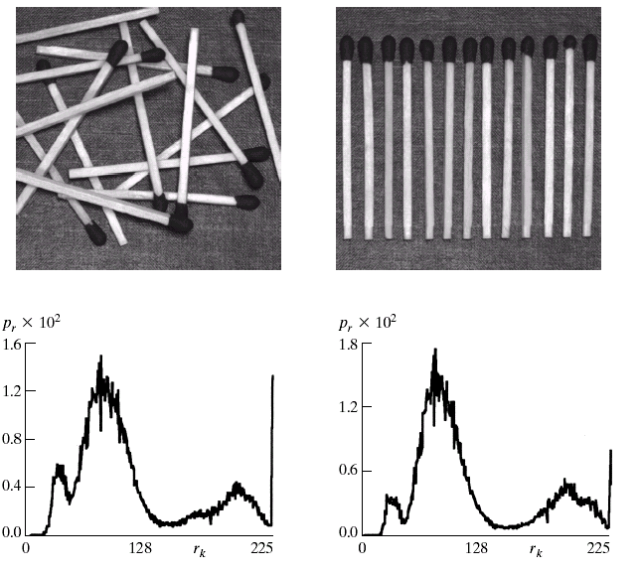
Interpixel / Interframe Redundancy
Here the two pictures have
Approximately the same
Histogram.
We must exploit Pixel
Dependencies.
Each pixel can be estimated
From its neighbors.

Slide 21
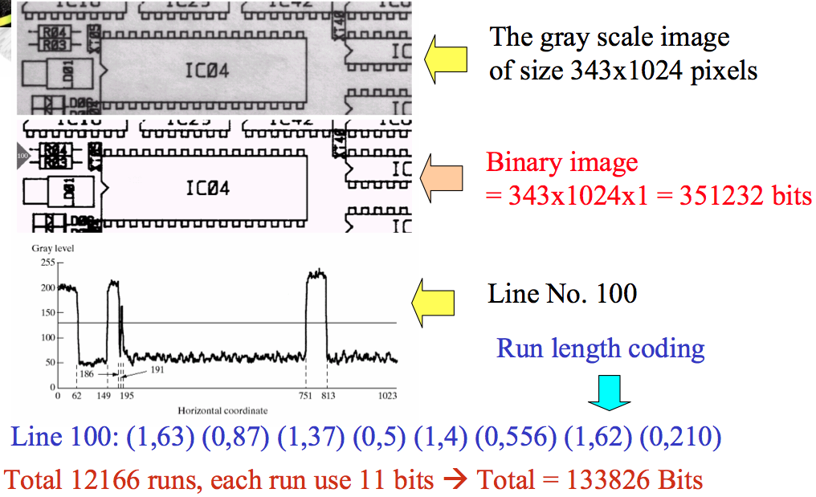
Run Length Coding
Notes:
21

Slide 22
Run Length Coding
Replace runs of equal brightness values by
(length of run, value)
1 2 2 3 3 4 4 4 5 6 5
(1 1) (2 2) (2 3) (3 4) (1 5) (1 6) (1 5)
More use when few brightness values
e.g. fax

Slide 23
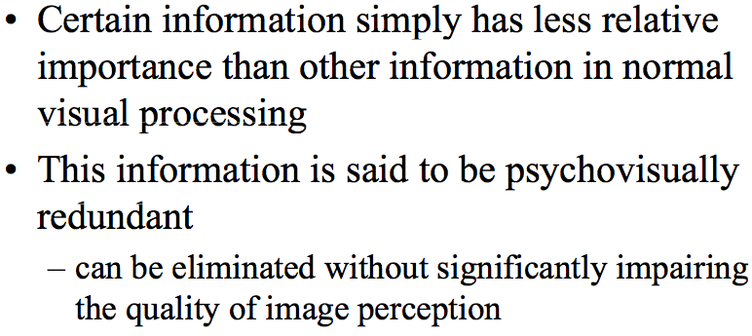
Psychovisual Redundancy
Notes:
23

Slide 24
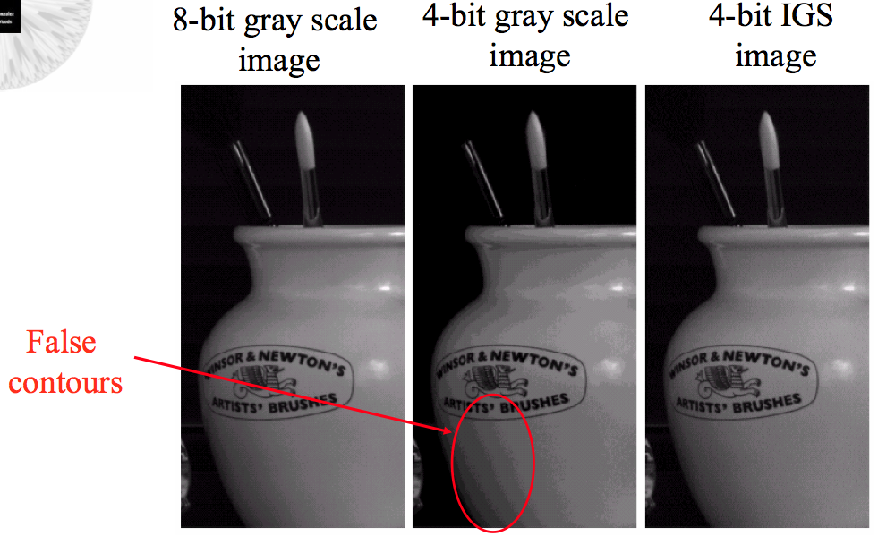
Psychovisual Redundancy
Notes:
24

Slide 25
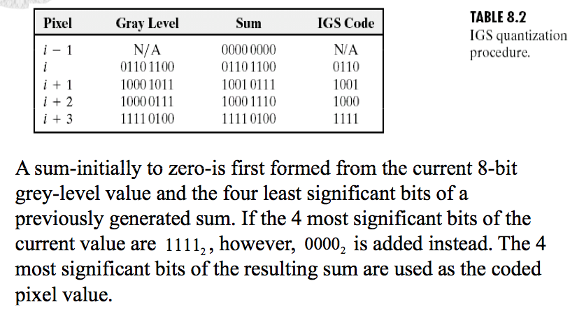
Psychovisual Redundancy
Notes:
25

Slide 26
Fidelity Criteria
The error between two functions is given by:
So, the total error between the two images is
The root-mean-square error averaged over the whole image is

Slide 27
Fidelity Criteria
A closely related objective fidelity criterion is the mean square signal to noise ratio of the compressed-decompressed image

Slide 28
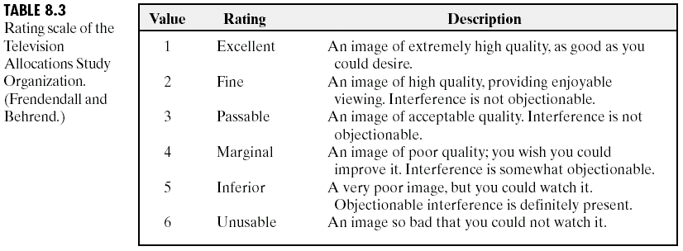
Fidelity Criteria

Slide 29
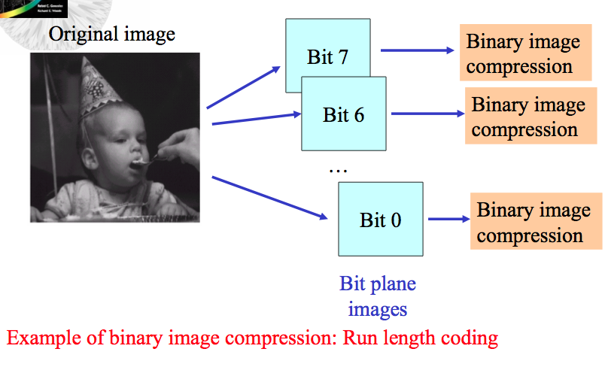
Bit Plane Coding
Notes:
29

Slide 30
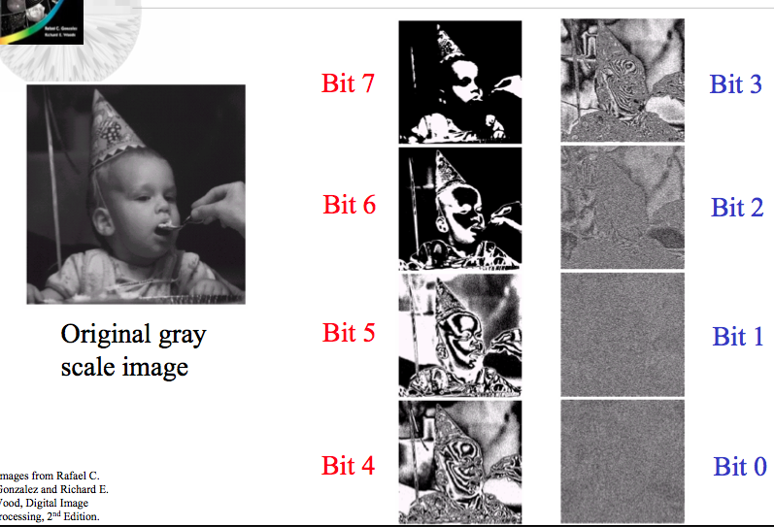
Bit Plane Coding
Notes:
30

Slide 31
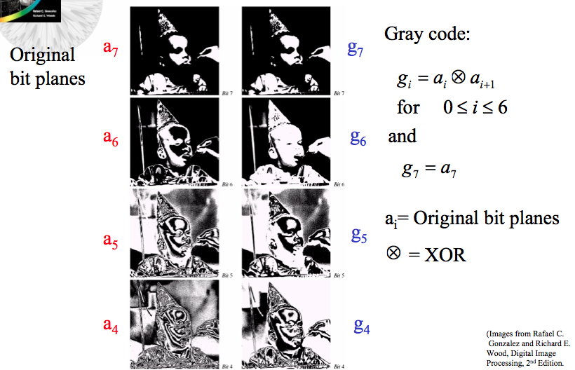
Gray Coded Bit Planes
Notes:
31

Slide 32
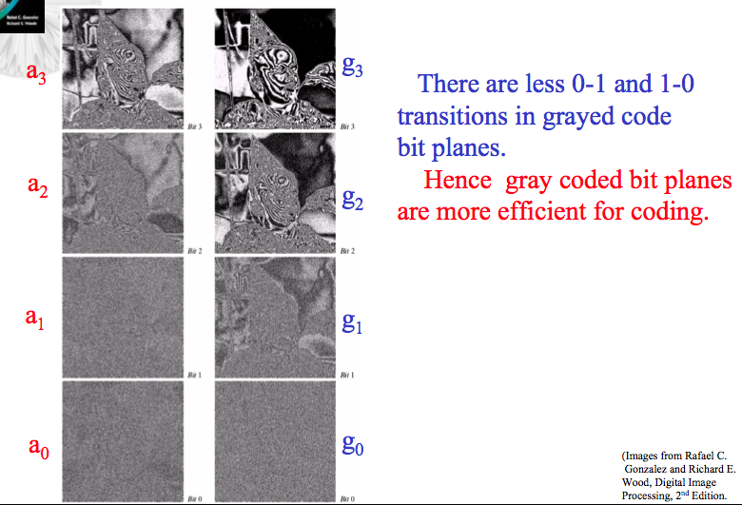
Gray Coded Bit Planes
Notes:
32

Slide 33
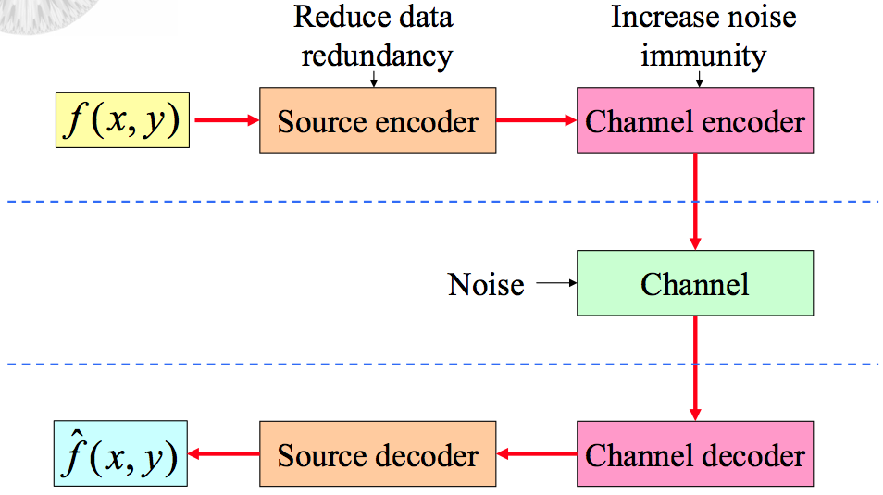
Image Compression Models
Notes:
33

Slide 34
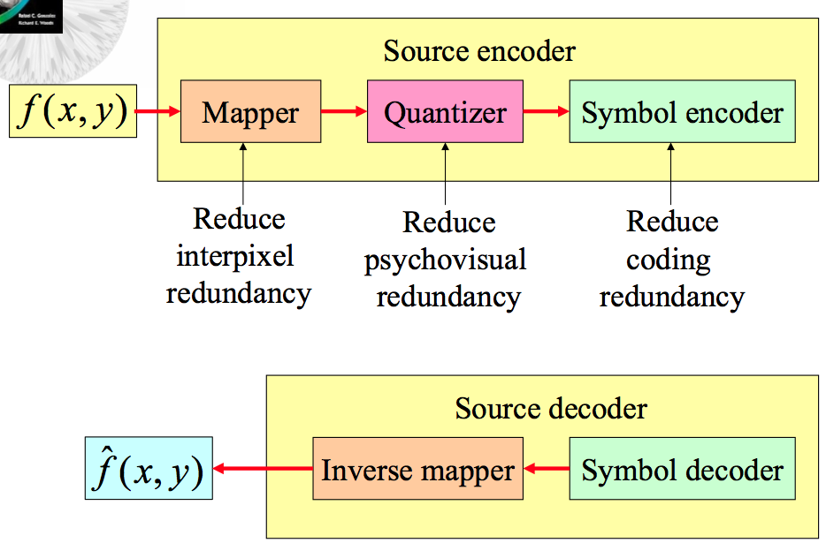
Source Encoder and Decoder Models
Notes:
34

Slide 35
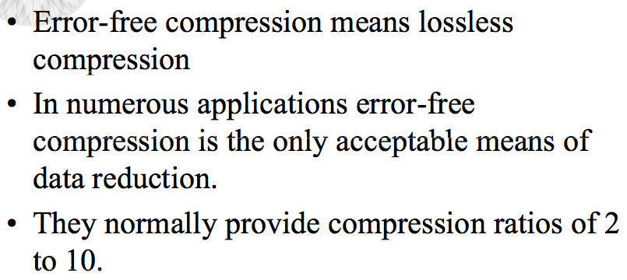
Error-Free Compression (Lossless)
Notes:
35

Slide 36
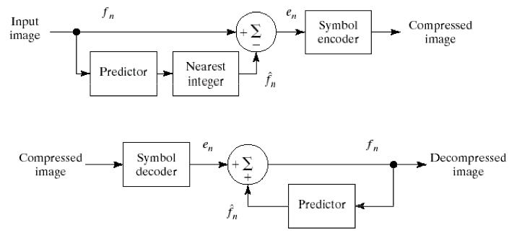
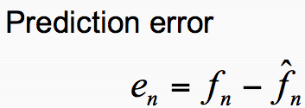
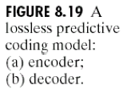
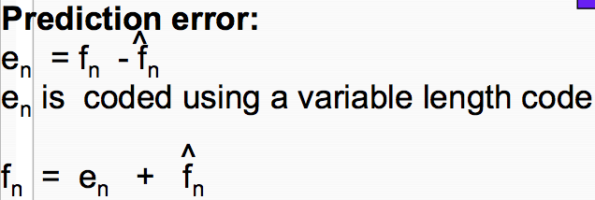
Lossless Predictive Coding Model
Notes:
36

Slide 37
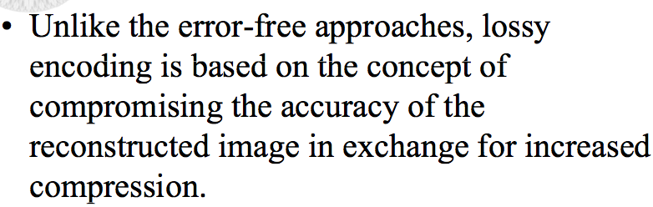
Lossy Compression
Notes:
37

Slide 38
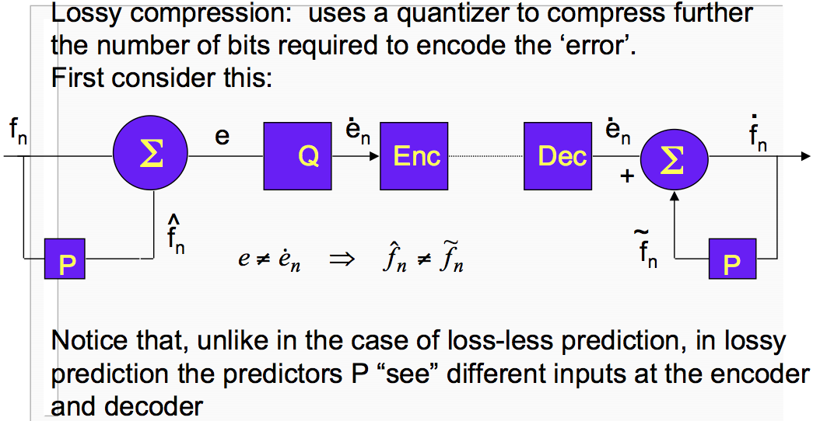
Lossy Compression
Notes:
38

Slide 39
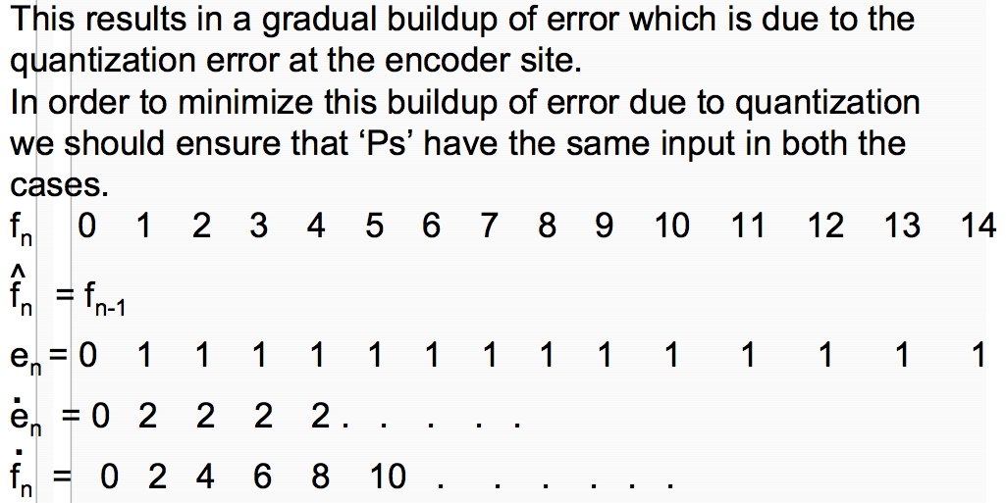
Lossy Compression
Notes:
39

Slide 40
Lossy Compression
0 | 0 | - | - | - | 0
1 | 1 | 0 | 1 | 2 | 2
2 | 2 | 1 | 1 | 2 | 4
3 | 3 | 2 | 1 | 2 | 6
4 | 4 | 3 | 1 | 2 | 8
5 | 5 | 4 | 1 | 2 | 10
6 | 6 | 5 | 1 | 2 | 12
Notes:
40

Slide 41
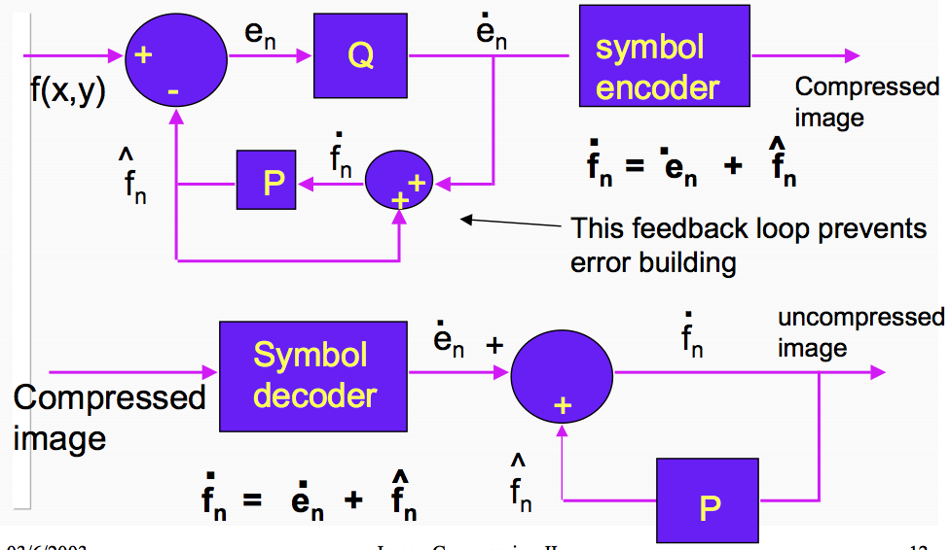
Lossy Compression
Notes:
41

Slide 42
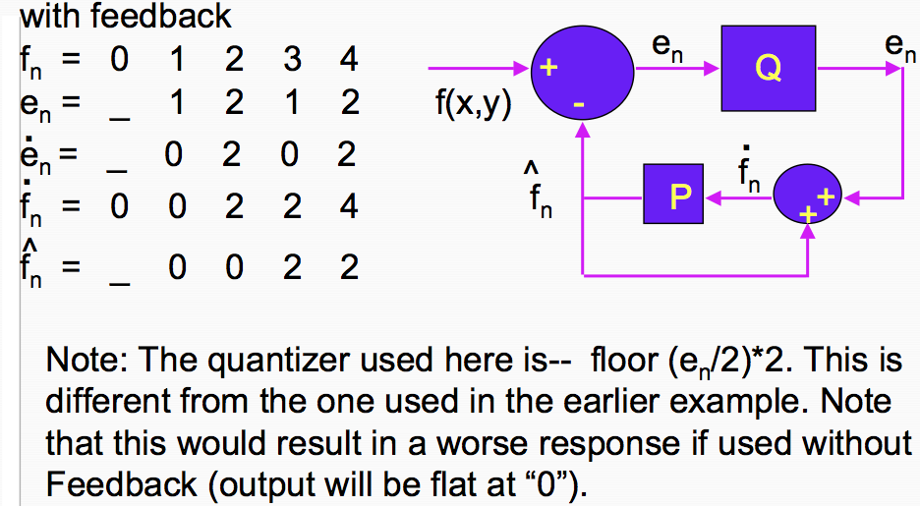
Lossy Compression
Notes:
42

Slide 43
Lossy Compression
0 | 0 | - | - | - | 0
1 | 1 | 0 | 1 | 0 | 0
2 | 2 | 0 | 2 | 2 | 2
3 | 3 | 2 | 1 | 0 | 2
4 | 4 | 2 | 2 | 2 | 4
Notes:
43

Slide 44
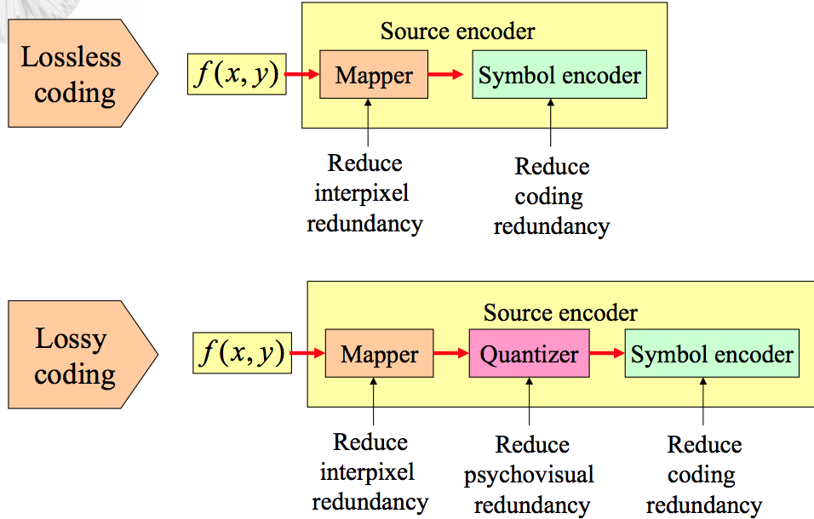
Lossless Vs. Lossy Coding
Notes:
44

Slide 45
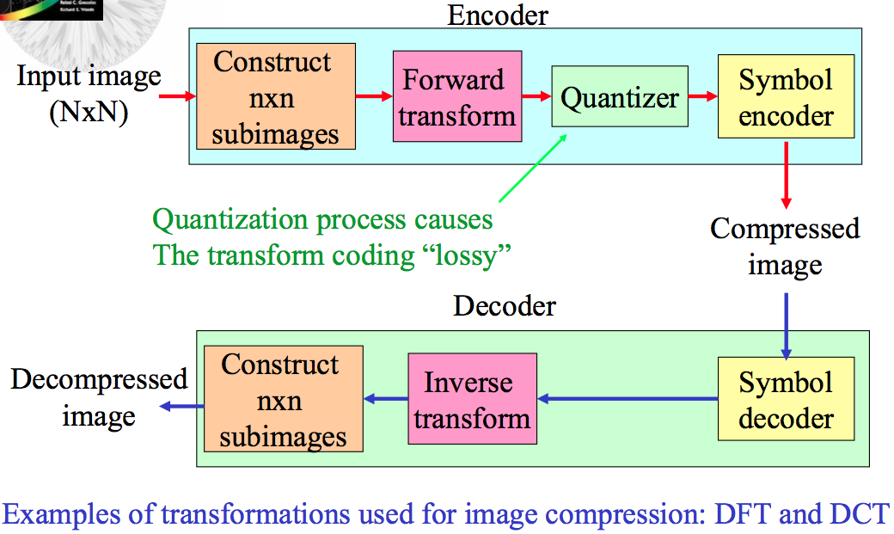
Transform Coding
Notes:
45

Slide 46
Thank You

